Slide 1




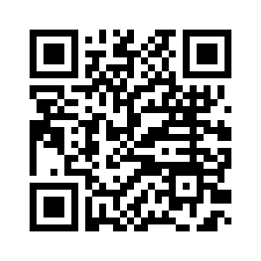
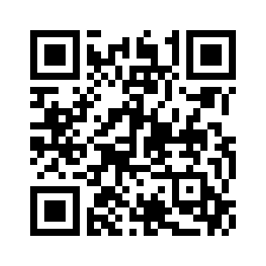











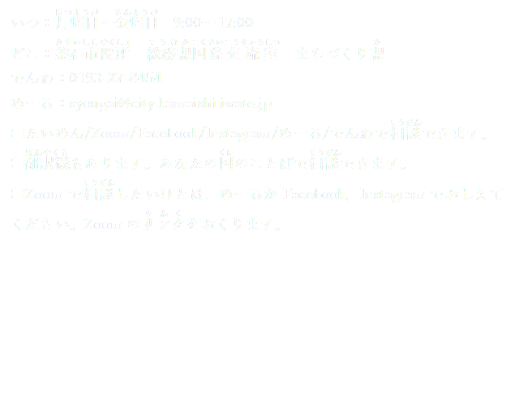


Consultation service for foreigners
Kamaishi City
ZOOMつかえます!
Kamaishi.city.japan

